Slide 1
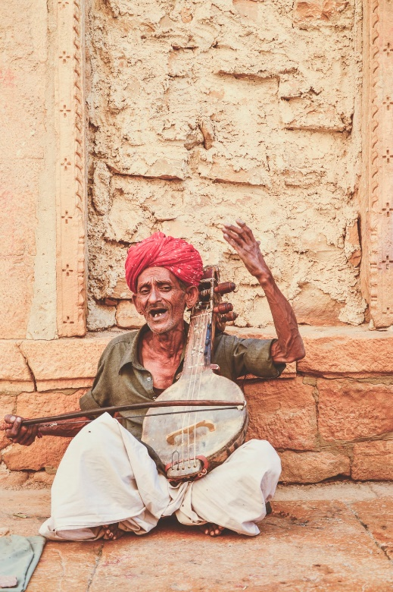
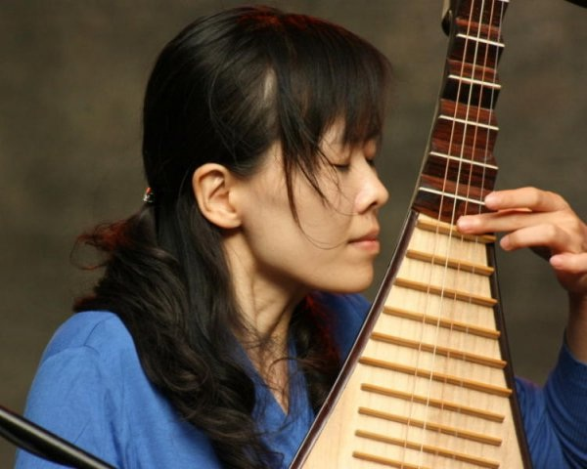
Tzu chi English Educational Helping future generations
Central points
How can we help future generations?
What can we reward in the future?
What can we measure in the future?
You are not only a descendent, but an ancestor?
Create a word bank for discussion
What do we reward?
Speaking
Being able to express your opinion
Listening
Active Listening with understanding
Creativity
Adding new thoughts to the discussion
Questions
Team Building
Asking poignant questions
What are you going to Sheppard in time?
What do we measure???
Skills Fostered in this Class
What is your story?
What can we measure that really matters in the future?
Christopher Bauman – www.chrisbauman.com.au

Slide 2
1. Metaphor for your life?
____________________________________________________________________________________________?
Advanced Question Words
It is easy to get caught up in things? What do you get caught up in?
________________________________________________________________________________________
Ephemeral-lasting a short time
Depleted
3. Can you conjure something positive in the future ___________________________________________________________________________________________ ?
Conjured
4. What do we measure today? (x3) Do they help future generations? ___________________________________________________________________________________________ ?
Learning and curiosity
5. What lessons from the past can be used to help future generations? ___________________________________________________________________________________________ ?
Imagine what is possible?
Music can resonate for generations
6.What is a share resource that future generations will need? ___________________________________________________________________________________________ ?
7. Who can you work with to help future generations? Who shares your thinking? ___________________________________________________________________________________________ ?
Begs the question
Heirloom
8. What is something that you can give to the next generation? ___________________________________________________________________________________________ ?
Marshal these tools
Who can you assist in their vision of helping future generations?
How can your passion be passed to the next generation?
Christopher Bauman – www.chrisbauman.com.au

